Slide 1
(Co)Existing Between Worlds: Liminality, Affordances, & the Virtuality of “The Outer Wilds”
2022 Digital Worlds Workshop, The Center for Collaboration & Ethics @ the University of Texas Rio Grande Valley
April 29 – May 1
Jordan D. Kokot
(www.jdkokot.com)

Slide 2
Outline
Introduction & Background: Phenomenology, Temporality, & Agency
Worlds & Realities: Alfred Schütz on the “Finite Provinces of Meaning”
Liminality, Lacuna, & Virtuality
“The Outer Wilds”: Time, Virtuality, and Transience
Conclusion: The Fundamental Liminality of Reality

Slide 3
“Game designers do not simply create worlds; they design temporary selves. Game designers set what our motivations are in the game and what our abilities will be... the fact that we play games shows something remarkable about us. Our agency is more fluid than we might have thought. In playing a game, we take on temporary ends; we submerge ourselves temporarily in an alternate agency”
-C. Thi Nguyen, Games: Agency as Art

Slide 4
“We call a certain set of experiences a finite province of meaning if all of the show a specific cognitive style and are – with respect to this style – not only consistent in themselves but also compatible with one another...To the cognitive style peculiar to each of these different provinces of meaning belongs, thus, a specific tension of consciousness and, consequently, also a specific epoché, prevalent form of spontaneity, a specific form of self experience, a specific form of sociality, and a specific time perspective” (15).
-Alfred Schütz, “On Multiple Realities”

Slide 5
Mobius Digital & Annapurna Interactive (2019)
2020 BAFTA Award
GotY 2019 (Giant Bomb, Polygon, Eurogamer, The Guardian, etc.)

Slide 6
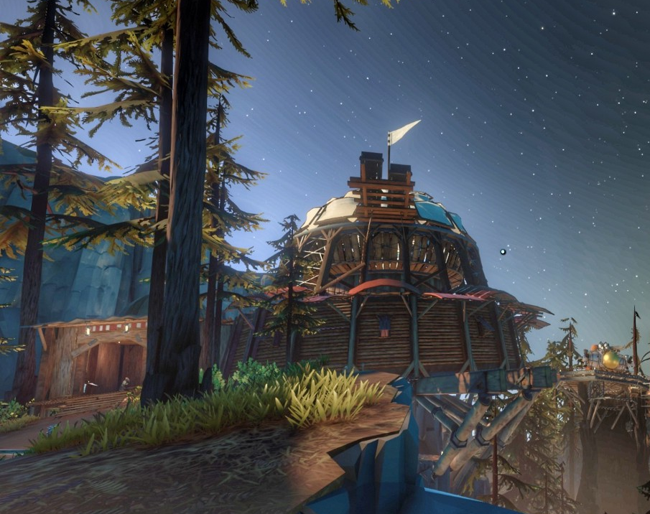
Introduction & Background: Phenomenology, Temporality, & Agency
Foundational Questions:
How are we to understand our radically different cognitive, dispositional, and normative capacities we exhibit in different worlds? How can we best characterize the ways we transition between worlds?
How do our experiences in different worlds inform each other? What persists between shifts in worlds, and what changes?
What are the effects of these transitions? How do the influence the development of persons who frequently shift between worlds? What are the broader social implications of frequent world shifting?

Slide 7
Introduction & Background: Phenomenology, Temporality, & Agency
Background Considerations:
Definitional Issues: world/reality, virtual/virtuality, VR/XR, etc.
Mediation Theory: technological mediation “is the source of the specific shape that human subjectivity and the objectivity of the world can take in this specific situation…subject and object are constituted in their mediation relation.” There is no “pre-given subject in a pre-give world of objects, with a mediating entity between them. Rather, the mediation is the source of the specific shape of that human subjectivity and the objectivity the world can take in that specific situation. Subject and object are constituted in their mediation relation. Intentionality is not a bridge between subject and object but a fountain from which the two of them emerge…Technologies, to be short, are not opposed to human existence; they are its very medium” (Rosenberger & Verbeek 2015).
Phenomenology of Time: “We are not saying that time exists for someone: this would be again to lay it out and to immobilize it. We are saying, rather, that time is someone or, in other words, that the temporal dimensions – insofar as they perpetually fit together – affirm each other, never do more than make explicit what was implied in each one, and each express a single rupture or a single thrust that is subjectivity itself. Time must be understood as the subject, and the subject must be understood as time” (Merleau-Ponty, 1945)

Slide 9
Part 2:
Worlds & Realities: Alfred Schütz on the “Finite Provinces of Meaning”

Slide 10
“Hence we call a certain set of our experiences a finite province of meaning if all of them show a specific cognitive style and are – with respect to this style – not only consistent in themselves but also compatible with one another. The italicized restriction is important because inconsistencies and incompatibilities of some experiences, all of them partaking of the same cognitive style, do not necessarily entail the withdrawal of the accent of reality from the respective province of meaning as a whole but merely the invalidation of the particular experience or experiences within that province.”
-Alfred Schütz, “On Multiple Realities”

Slide 11
Worlds & Realities: Alfred Schütz on the “Finite Provinces of Meaning”
Cognitive Styles: “As an example let us consider again the world of everyday life as it was defined and analyzed in the preceding chapter. This world is certainly a “sub-universe” or “finite province of meaning” among many others, although one marked out as ultimate or paramount reality for the reasons mentioned in the last section. If. we recapitulate the basic characteristics which constitute its specific cognitive style we find
a specific tension of consciousness, namely wide-awakeness, originating in full attention to life;
a specific epoché, namely suspension of doubt
a prevalent form of spontaneity, namely working...
a specific form of experiencing one’s self (the working self as the total self)
a specific form of sociality (the common intersubjective world of communication and social action)
a specific time-perspective (the standard time originating in an intersection between durée and cosmic time as the universal temporal structure of the intersubjective world).

Slide 12
“...As long as our experiences of this world – the valid as well as the invalidated ones – partake of this style we may consider this province of meaning as real, we may bestow upon it the accent of reality...” “...Even more, this reality seems to us to be the natural one, and we are not ready to abandon our attitude toward it without having experienced a specific shock which compels us to break through the limits of this “finite” province of meaning and to shift the accent of reality to another one...” “...To be sure those experiences of shock befall me frequently amidst my daily life; they themselves pertain to its reality. They show me that the world of working in standard time is not the sole finite province of meaning but only one of many others accessible to my intentional life...”
-Alfred Schütz, “On Multiple Realities”

Slide 13
Part 3:
Liminality, Lacuna, and Virtual Reality

Slide 14
Six Forms of Liminality
 | Overview | Design Decisions | Transition Function | Example
Direct Memory | generate and manipulate memories | Repetition, Goal Manipulation | Direct, Immediate, Transcendent | Shadow of the Colossus (2005)
Skills & Affordances | require users to develop and deploy skills and dispositions | UI Design, Repetition, World Design, Physics Models, Puzzles | Indirect, Immediate, Situational | Microsoft Flight Simulator (2022)
Epistemic Structures | generate beliefs, some of which transcend | Direct Instruction, Problem Solving | Direct, Mediated, Situational | Educational Software
Emotions & Moods | generate moods and emotions that carry over | Narrative, Filmic Elements, Agency Manipulation | Direct, Immediate, Transcendent | That Dragon, Cancer (2016)
Social Ties | can create trans-world relationships | Avatar Design, Communication Modality, Economy | Indirect, Mediated, Situational | Metaverse/Social Media/MMORPGs
Transcendental | reveal basic structures of worlds as such | Narrative, Structural, Temporal | Direct?, Immediate, Universal | The Outer Wilds (2019)

Slide 15
Liminality, Lacuna, and Virtual Reality
Transition Function: Each form of liminality allows for transitions between zones in different ways. Three basic categories of this function are directness, immediacy, and domain
Directness: a form of liminality can either be direct or indirect in terms of its causal relationship to the world the starting world (essentially maps onto the thematic/non-thematic distinction)
Immediacy: a form of liminality can be either immediate or mediated in terms of how it shows up in a world other than what it started in
Domain: a form of liminality can be either situational, in that it can be directly applied to multiple worlds, transcendent, in that it carries over to the next world almost automatically, or it can be universal in that, once uncovered, it applies to all worlds.

Slide 16
Liminality, Lacuna, and Virtual Reality
These Transition Functions characterize how Schutz six aspects of cognitive style manifest across worlds.
Cognitive Style
Virtual World
(Flight Simulator)
“real” World
(flying a Plane)
Tension of Consciousness
Epoché
Form of Spontaneity
Form of Experiencing One’s Self
Form of Sociality
Time-Perspective
Task focus, immediacy, immersion
Bracketing external concerns/epistemic immediacy. Virtual.
Response to immediate stimuli, non-anxious
As a pilot* (digital tower, etc)
Virtual intersubjective world
Governed by the needs of the moment. Virtual (Repeatable)
Task focus, immediacy, immersion
Bracketing external concerns/epistemic immediacy
Response to immediate stimuli, anxious
As a pilot
Full intersubjective world
Governed by the needs of the moment. Non-repeatable
When the pilot* leaves Flight Simulator, they bring with them memories, skills and affordances, epistemic structures, and emotions and moods. These then inform and structure the cognitive style they take on when actually flying a plane. But they do not keep the same time perspective.

Slide 17
Part 4:
The Outer Wilds: Time, Virtuality, and Transcendence

Slide 19
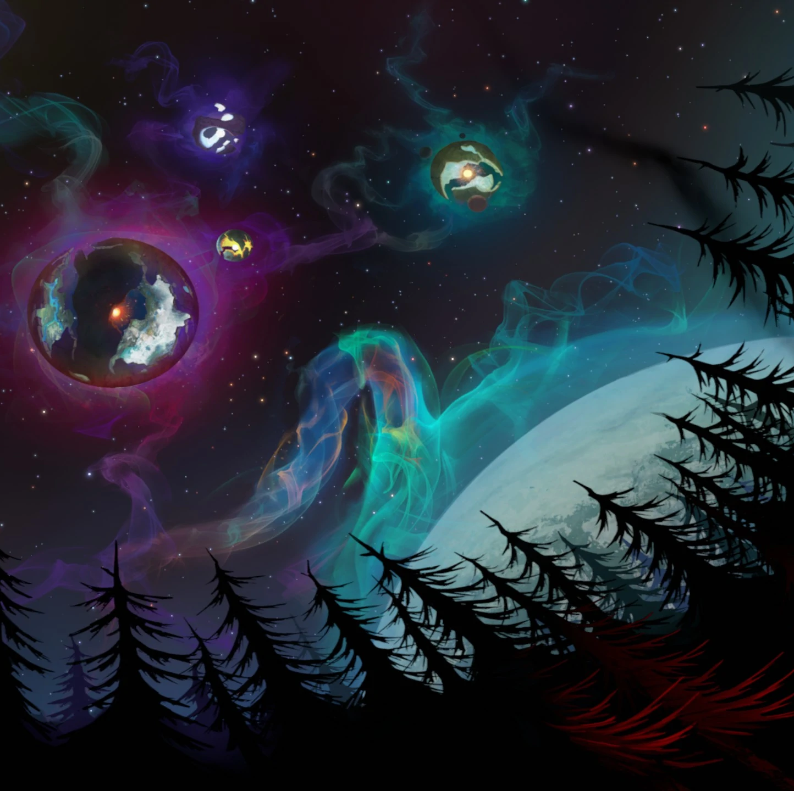
The Outer Wilds: Time, Virtuality, and Transcendence
Cognitive Style:
Tension of Consciousness: Immediacy, Immersion, Action
Epoché: bracketing external concerns, epistemic immediacy, virtual
Form of Spontaneity: response to stimuli, problem solving, mostly non-anxious (till the end)
Form of Experiencing One’s-Self: as player/avatar
Form of Sociality: virtual
Time-Perspective: ????

Slide 20
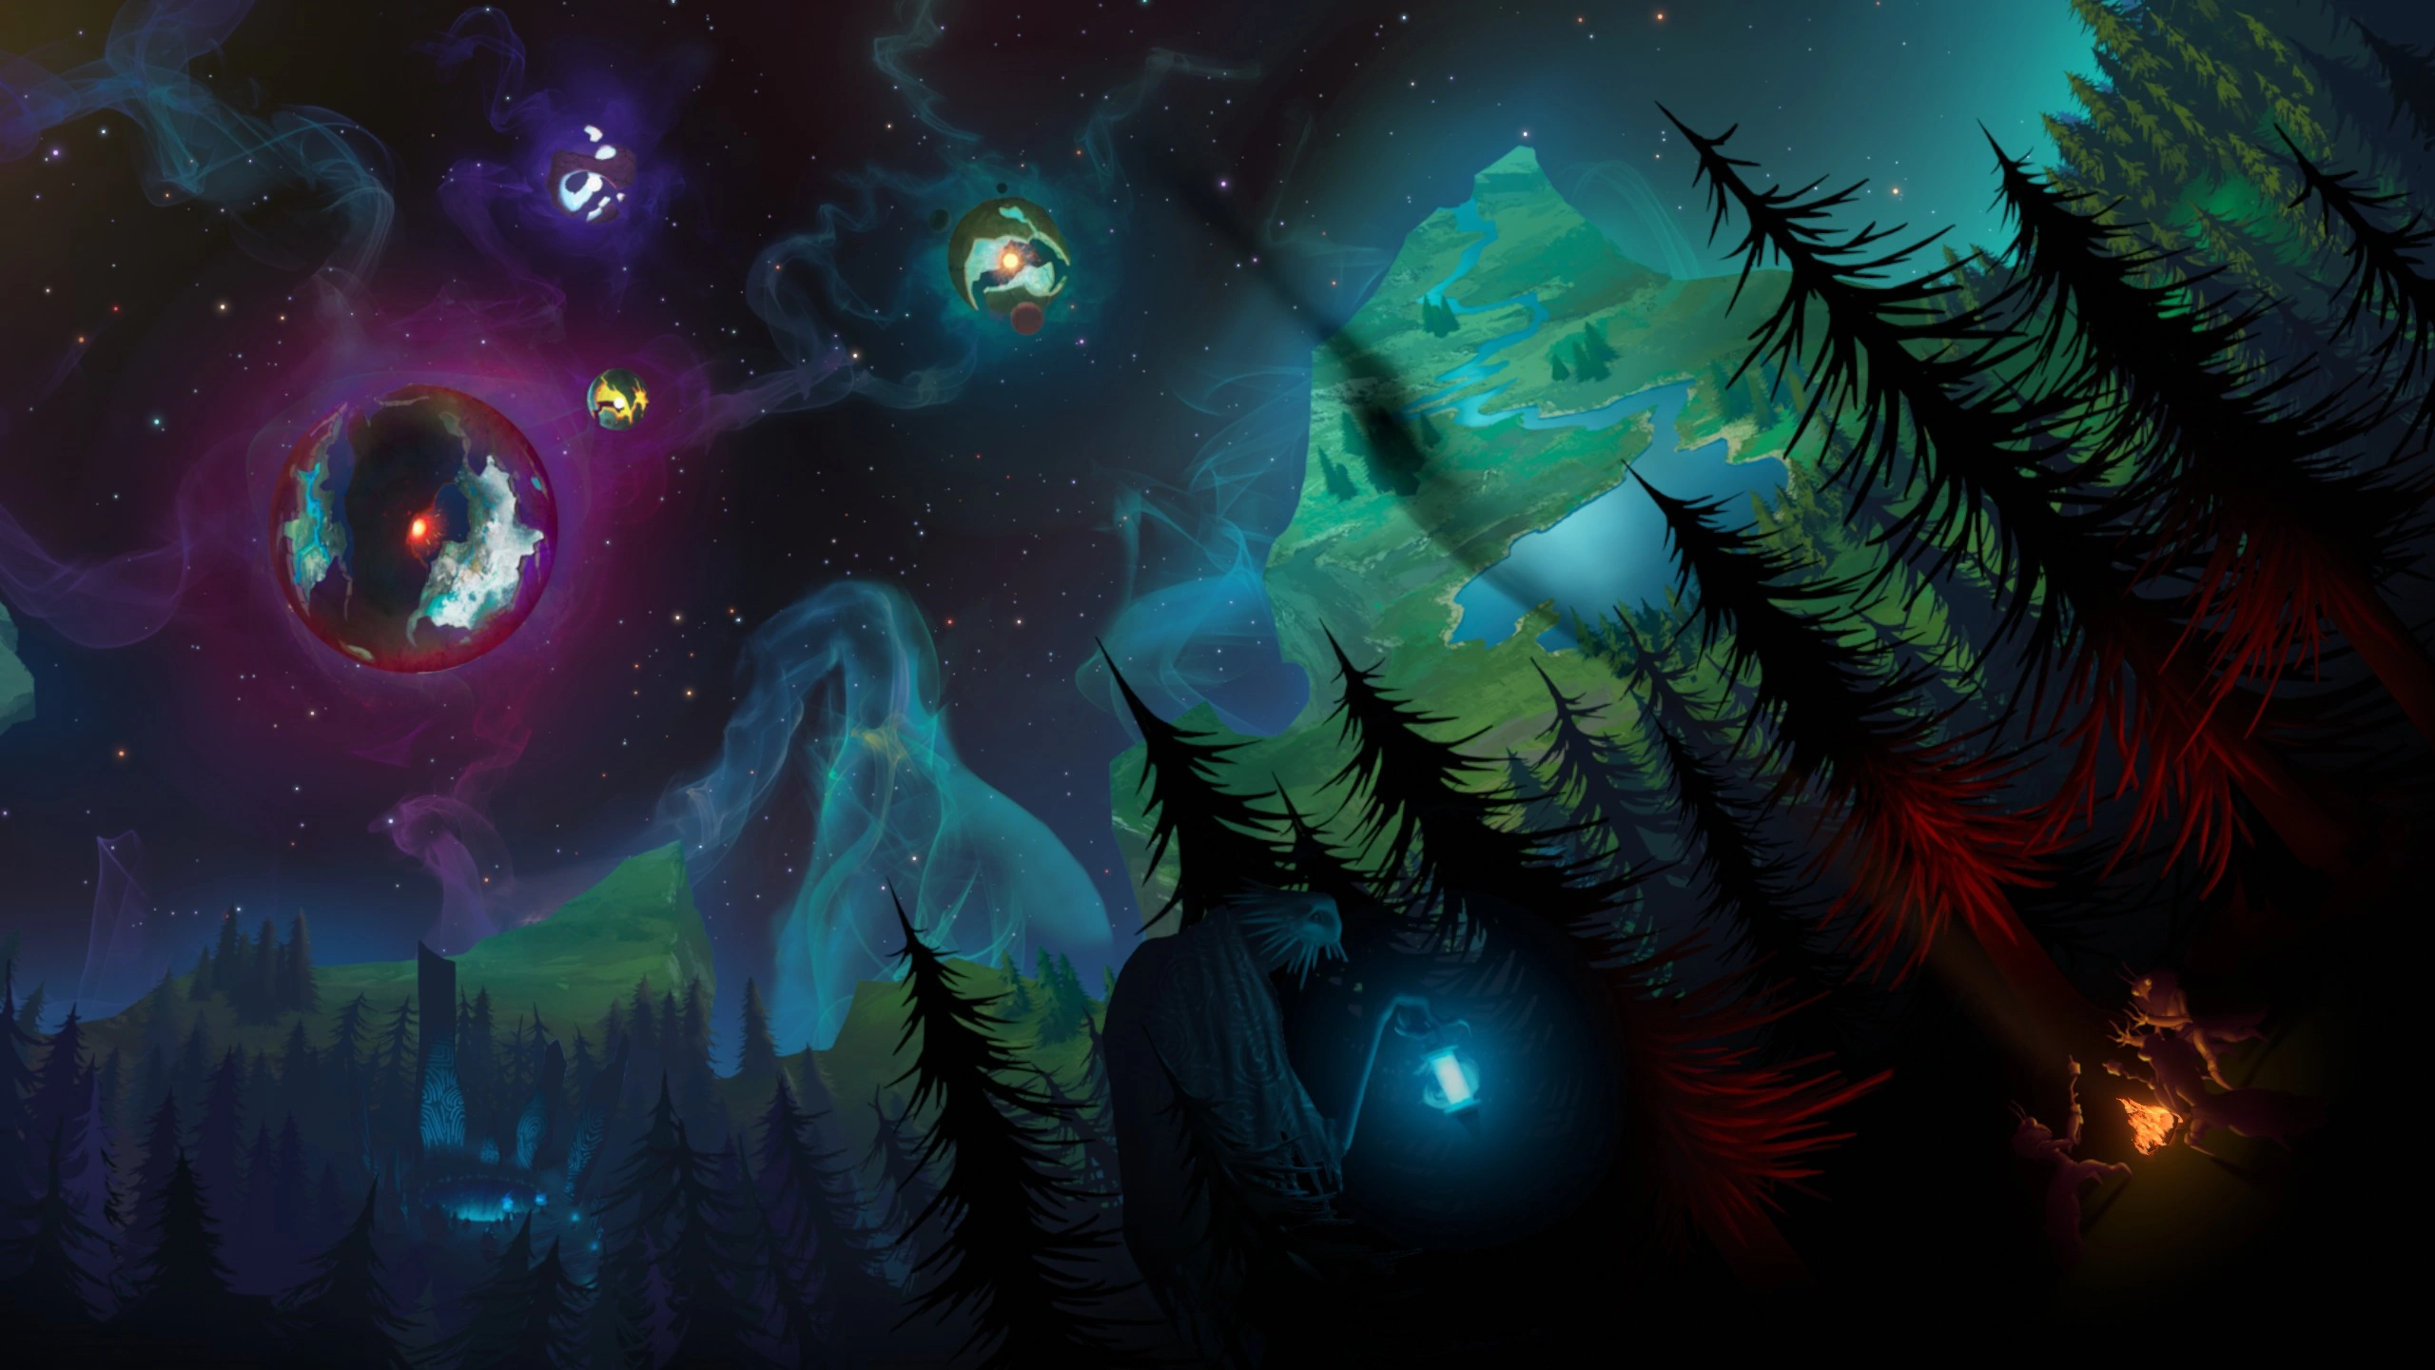
Proposal: Certain virtual worlds, specifically those that manipulate user’s Time-Perspective, allow for transcendental liminalities, or engagements with fundamental features of worlds as such. Outer Wilds draws the player’s attention to the fact that, though they may currently inhabit a fictional virtual reality, that reality is still structured by the inexorable progression of personal time and the radical particularity (or the resolute urgency) of each moment. All realities depend on other realities for their very realness, even though whatever reality an individual currently inhabits dominates their sense of the real. Examples like The Outer Wilds demonstrate that we can gain insights into the liminal character of reality in general through exploring the possibilities of virtuality.

Slide 21
Thank you Contact: Jdkokot@bu.edu Website: www.jdkokot.com
Artwork: Wesley Martin Mojang Studios

